Slide 1

An Application on Home Hospitalization using Cloud Computing
Guided by:
Name: M.Lavanya
Designation: AP III
Department: ICT
School of Computing
SASTRA University
Presented By:
Name : Pavithra S,Sai Kiruthika S,Iswariya K
Register Number:121015073,121015085,121015041
Department : Information Technology
SASTRA University

Slide 2

Base Paper
Hafedh Ben Hassen ,Nadia Ayari ,Belgacem Hamdi . “A home hospitalization system based on Internet of things, Fog computing and cloud computing”.Informatics in Medicine Unlocked.Volume 20, 2020
URL: https://doi.org/10.1016/j.imu.2020.100368

Slide 3

Objective
In recent years, the world has witnessed a significant increase in the number of people who often suffer from chronic diseases, and has witnessed in recent months a major spread of the new coronavirus (COVID-19), which has led to more number of deaths.
To reduce the spread of the virus and maintain the health of patients who need a hospital stay, home hospitalization is one of the best possible solutions.
This project proposes a home hospitalization system based on the Cloud computing, which is the most important technology that have contributed to the development of the healthcare sector in a significant way.
These systems allow patients to recover and receive treatment in their homes and among their families. A Web Application is developed for this purpose.

Slide 4
PROBLEM STATEMENT
During this current pandemic situation to reduce the spread of Corona virus and to maintain the health of patients,finding a technical solution to address this problem.A Home Hospitalization system is proposed.

Slide 5

Literature survey
Paper Title 1 :A survey on fog computing for the Internet of Things
URL:https://www.sciencedirect.com/science/article/abs/pii/S1574119218301111?via%3Dihub
Reference: In this paper we referenced a unified architectural model and a new taxonomy, by comparing a large number of solutions. Finally, we draw some conclusions and guidelines for the development of IoT applications based on fog.
Paper Title 2:Privacy in the Internet of Things for Smart Healthcare
URL:https://ieeexplore.ieee.org/document/8337893
Reference: In this we referenced security vulnerabilities of password building and presents a password strength evaluation method that takes into account users' personal information.

Slide 6
Paper title 3: An E-health system for monitoring elderly health based on Internet of Things and Fog computing.
URL: https://doi.org/10.1007/s13755-019-0087-z.
Reference:This paper proposes an e-health system for monitoring elderly health based on the Internet of Things (IoT) and Fog computing. The system was developed using Mysignals HW V2 platform and an Android app that plays the role of Fog server, which enables the collection of physiological parameters and general health parameters from elderly periodically
Paper Title 4: An IoT based SMART patient health monitoring system
URL: http://ijeecs.iaescore.com/index.php/IJEECS/article/view/20453
Reference: This paper proposes to design and create a healthcare system centered on Mobile-IoT by collecting patient information from different sensors and alerting both the guardian and the doctor by sending emails and SMS in a timely manner. It remotely monitors the physiological parameters of the patient and diagnoses the illnesses swiftly.

Slide 7

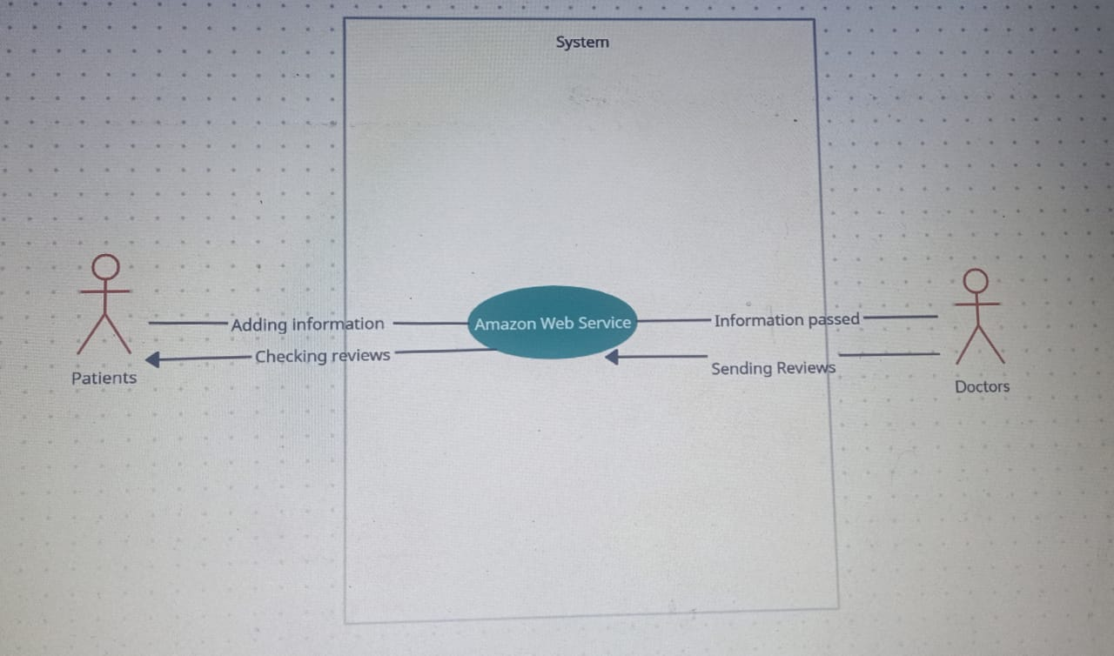
Proposed Methods
Flow Diagram

Slide 8
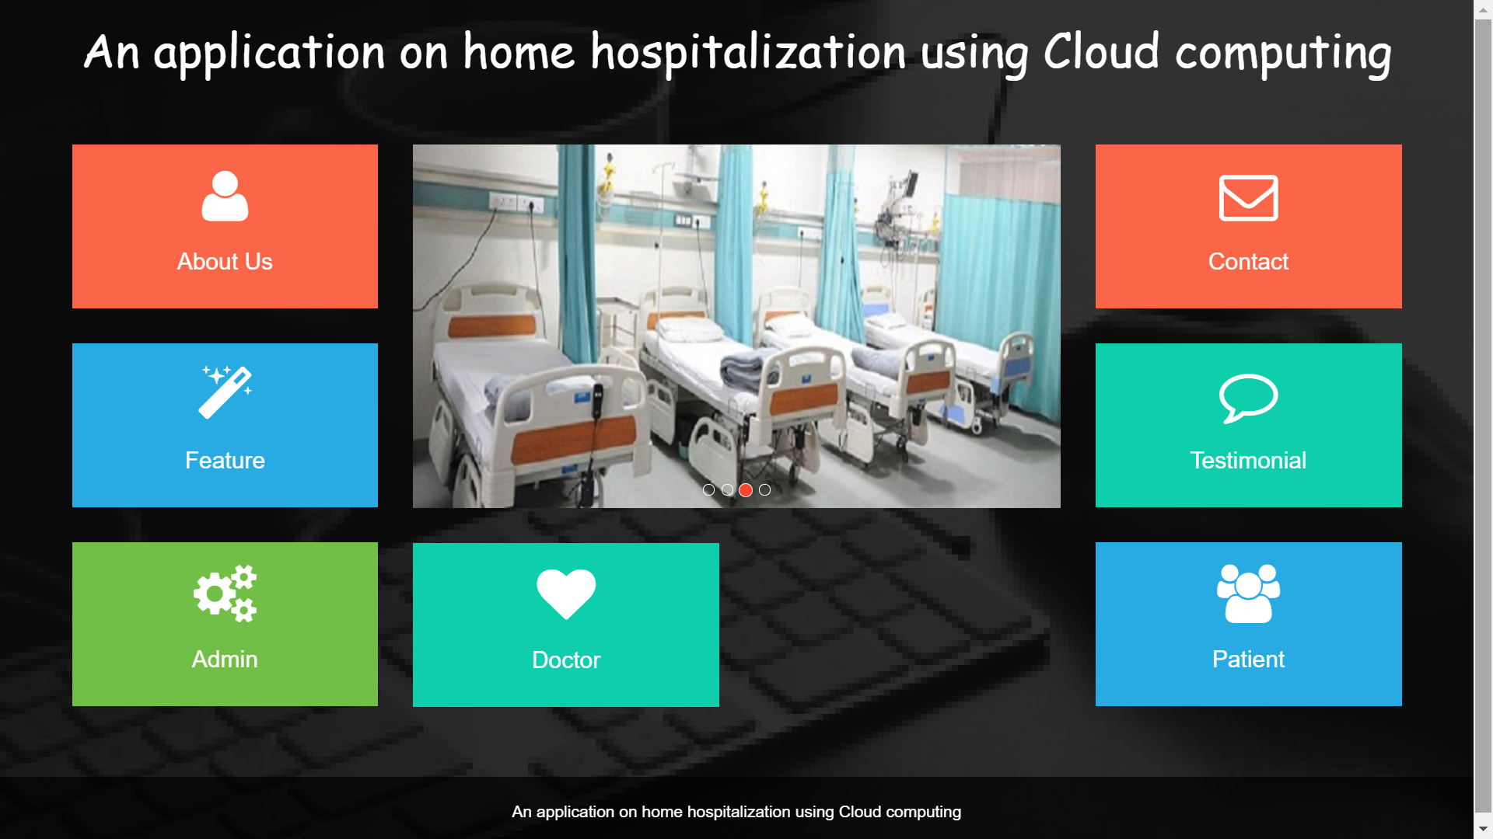
OUTPUT

Slide 9
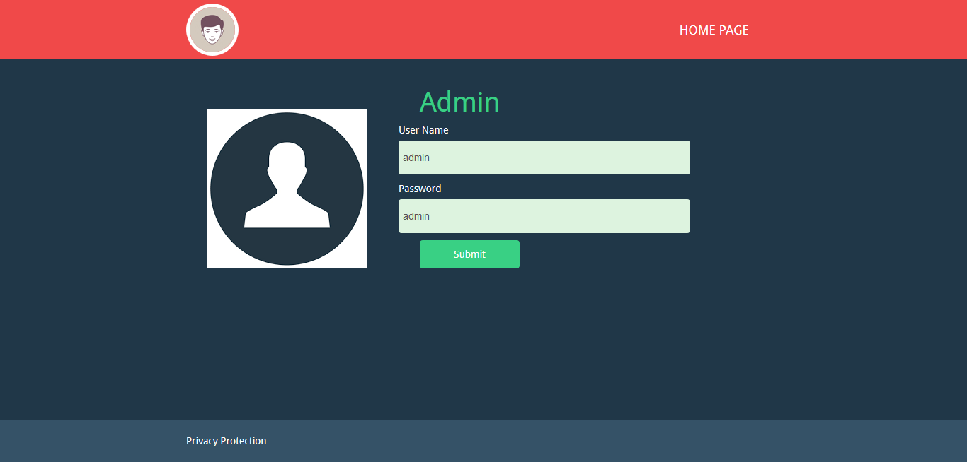
OUTPUT

Slide 10
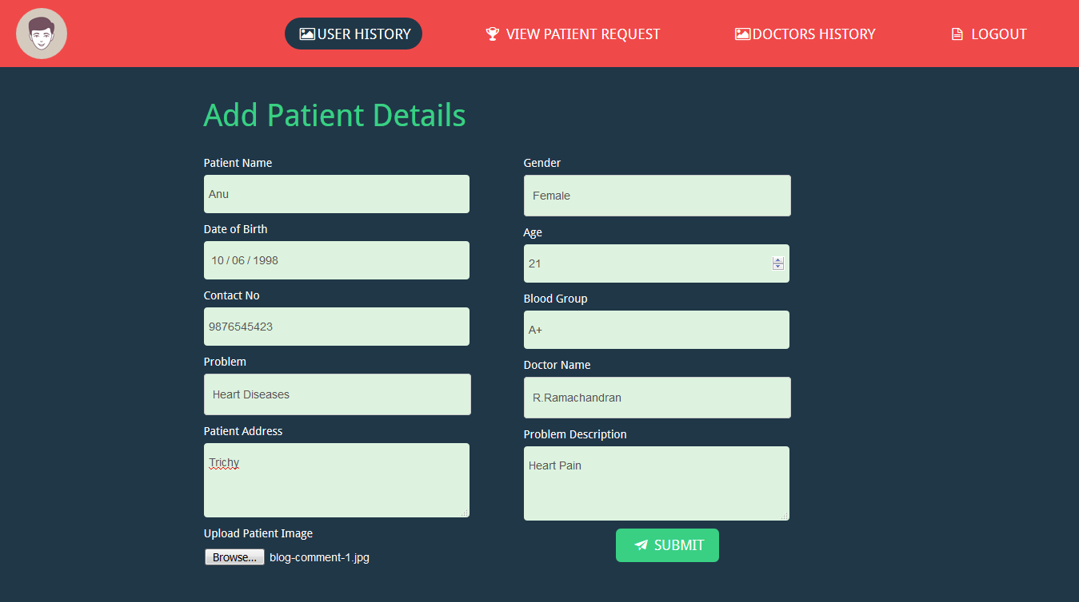
OUTPUT

Slide 11
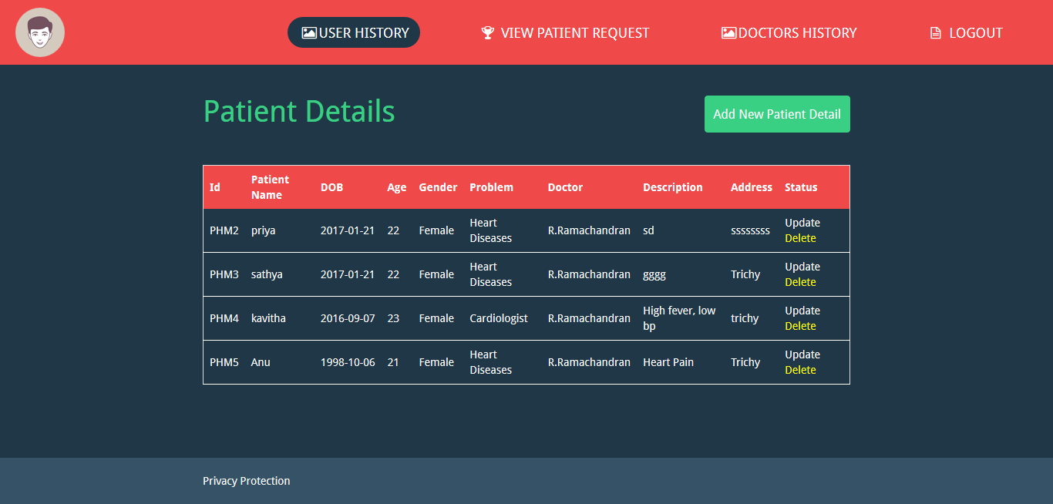
OUTPUT

Slide 12
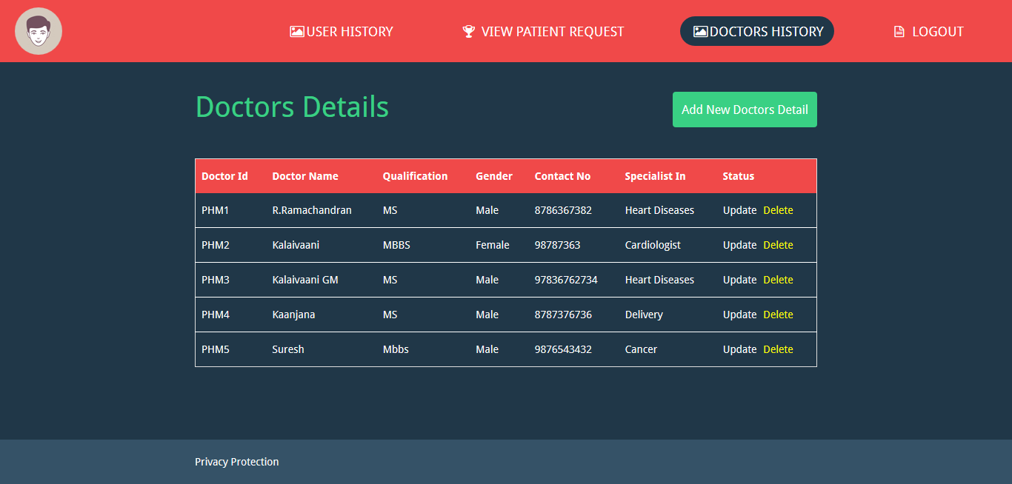
OUTPUT

Slide 13
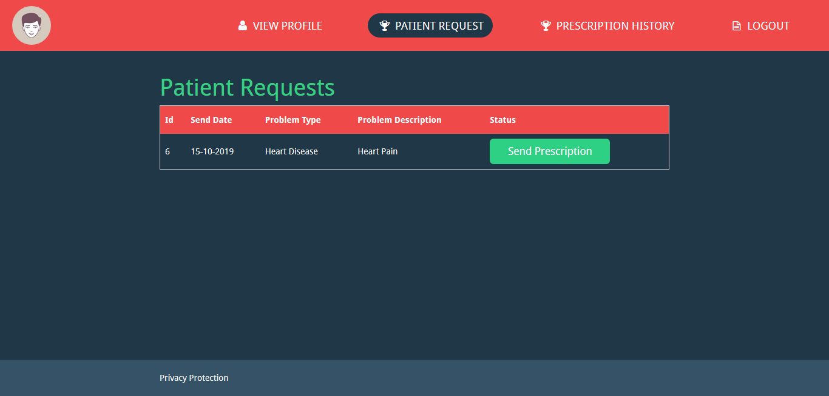
OUTPUT

Slide 14
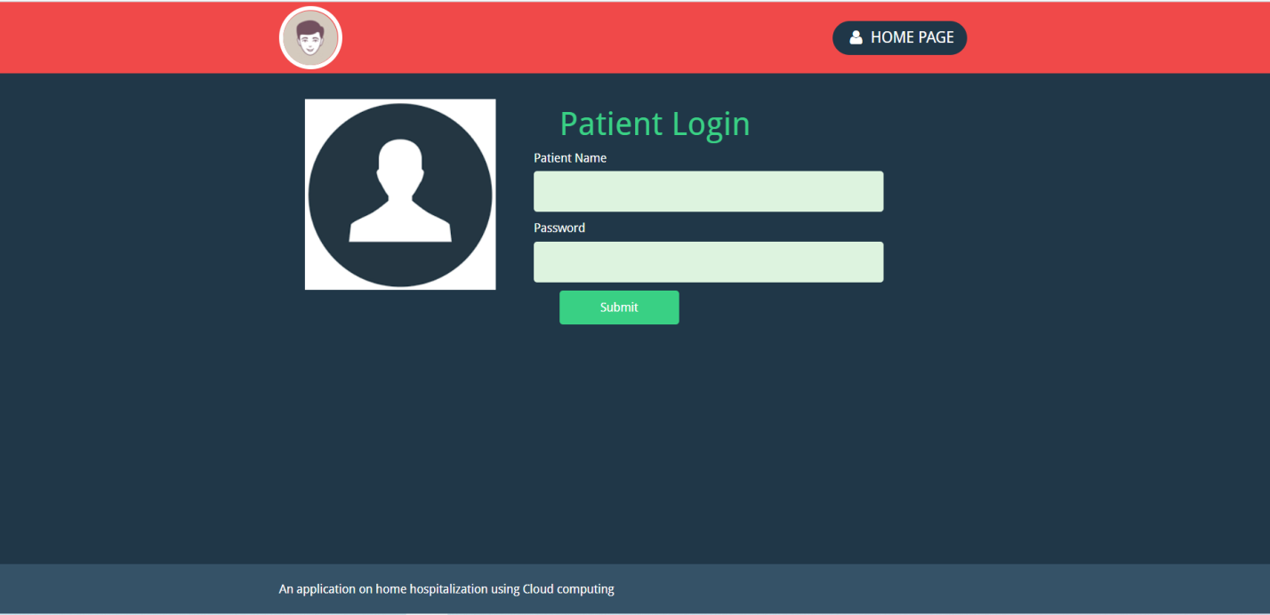
OUTPUT

Slide 15
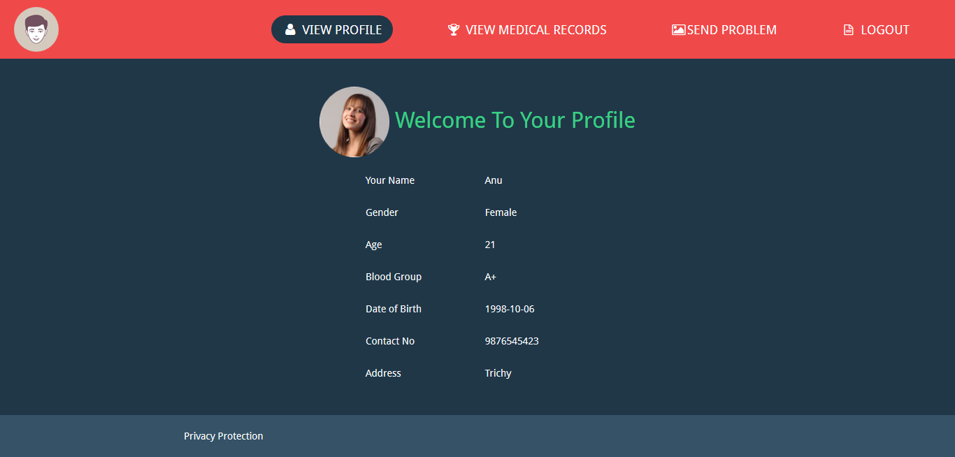
OUTPUT

Slide 16
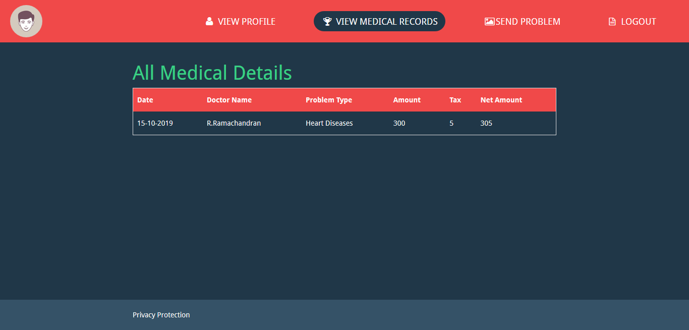
OUTPUT

Slide 17
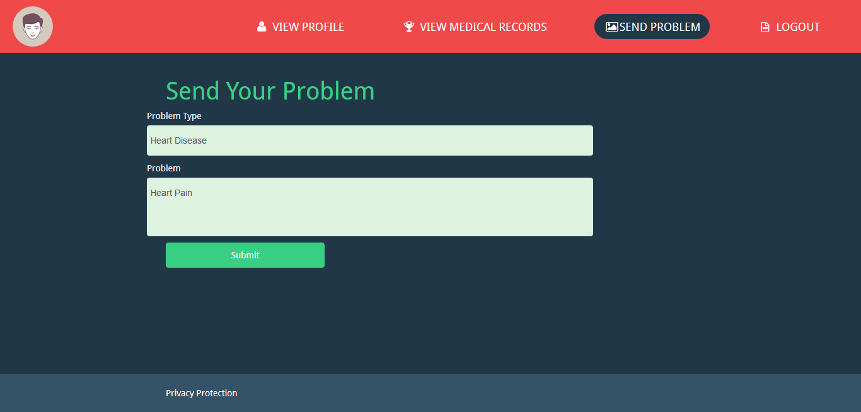
OUTPUT

Slide 18
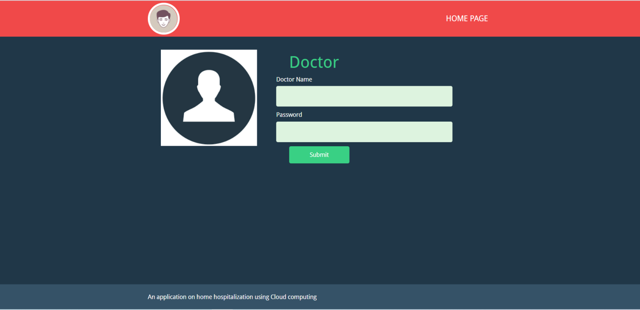
OUTPUT

Slide 19
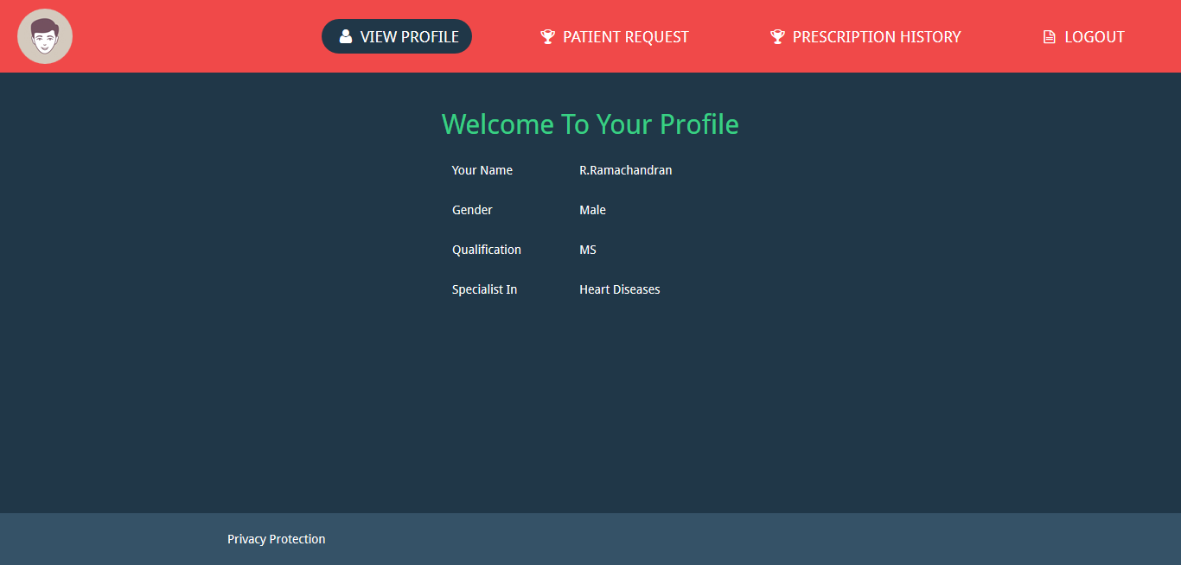
OUTPUT

Slide 20
OUTPUT

Slide 21
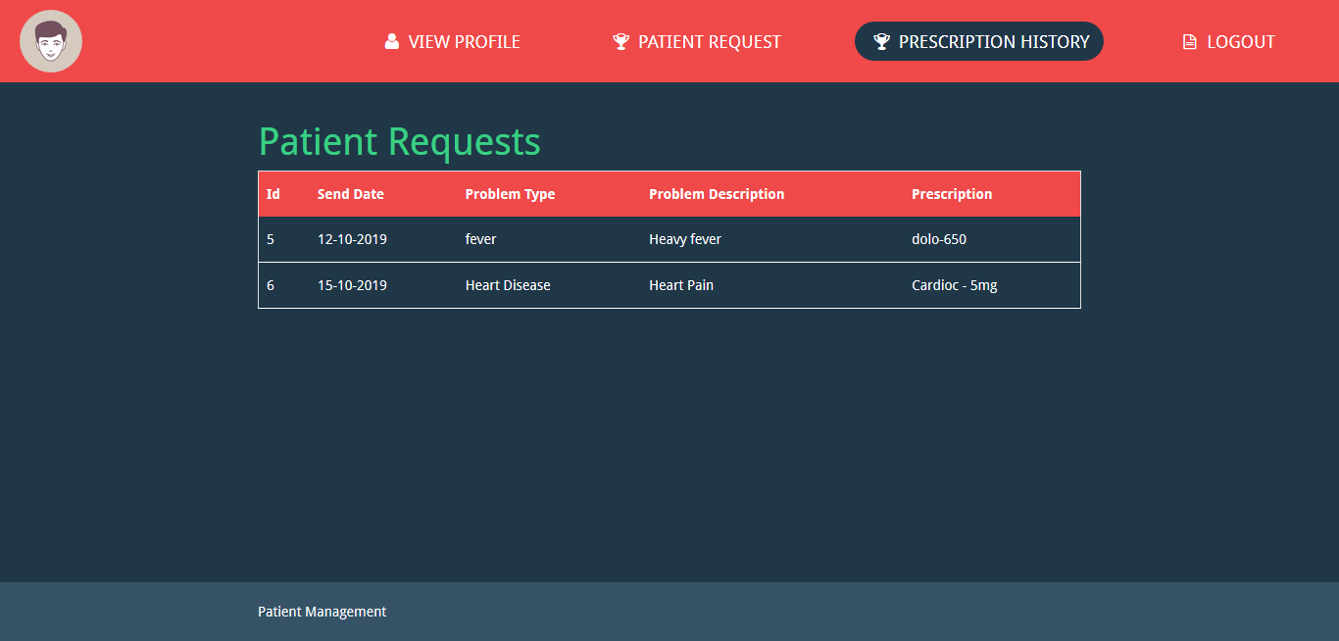
OUTPUT

Slide 22
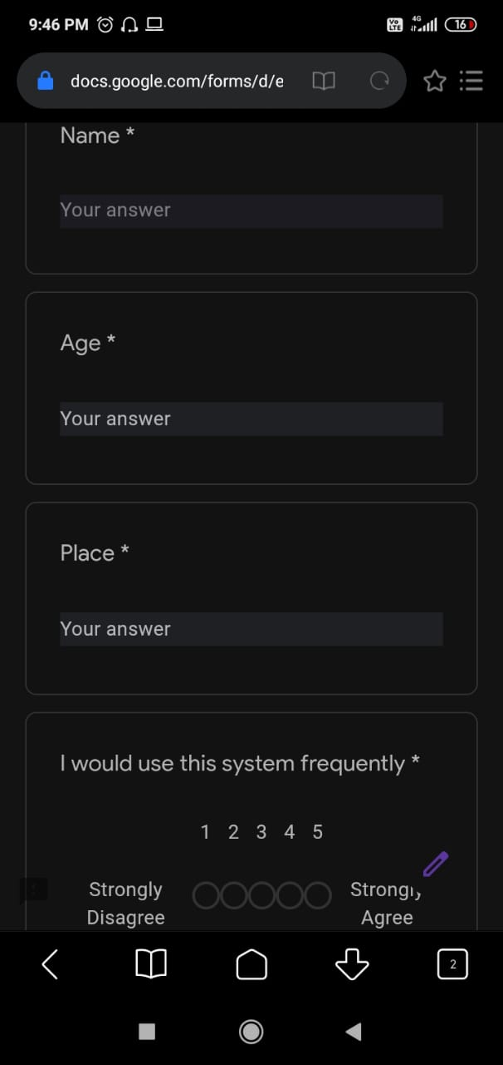
SURVEY COLLECTED FROM DOCTORS AND PATIENTS

Slide 23
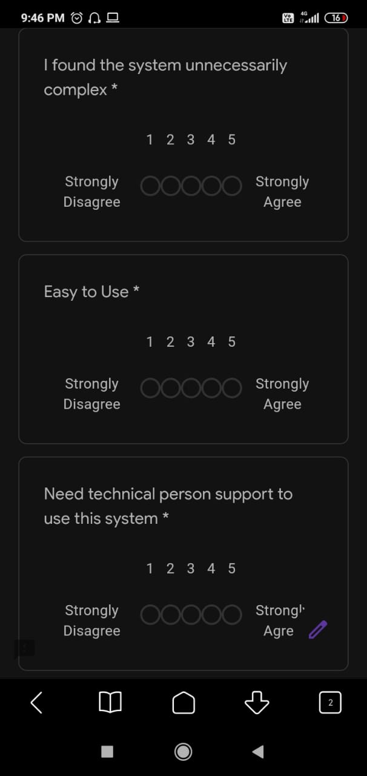
SURVEY COLLECTED FROM DOCTORS AND PATIENTS

Slide 24
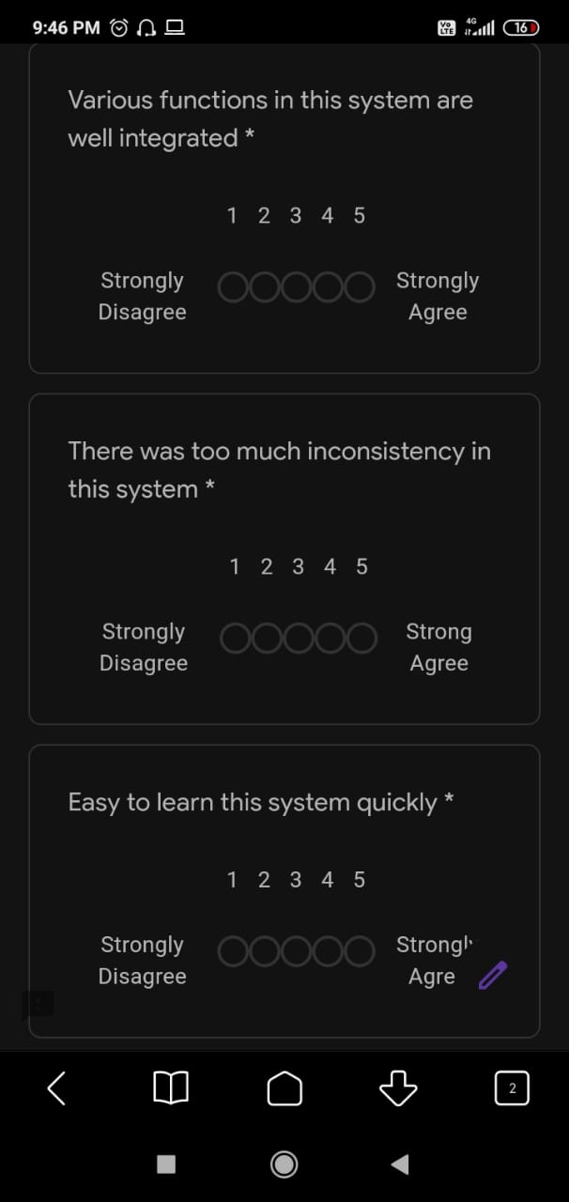
SURVEY COLLECTED FROM DOCTORS AND PATIENTS

Slide 25
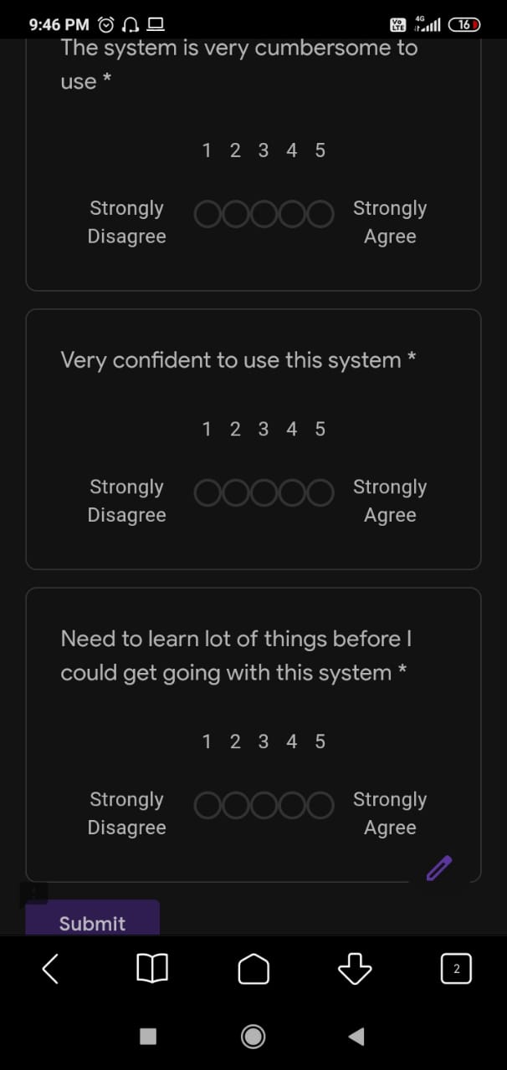
SURVEY COLLECTED FROM DOCTORS AND PATIENTS

Slide 26
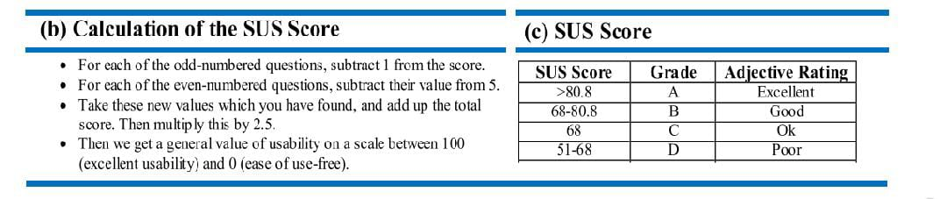
CALCULATION OF SUS SCORE

Slide 27
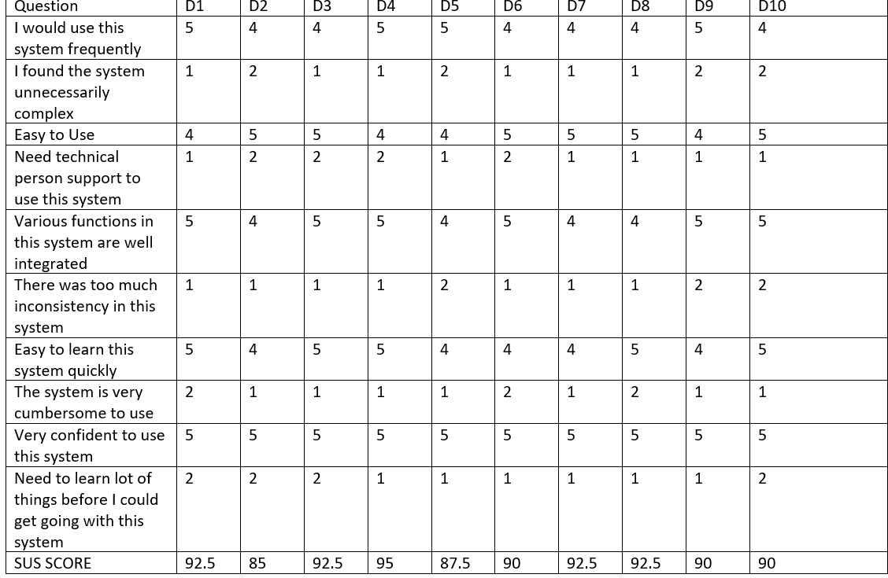
DOCTORS SUS Questionnaire
Average SUS Score =

Slide 28

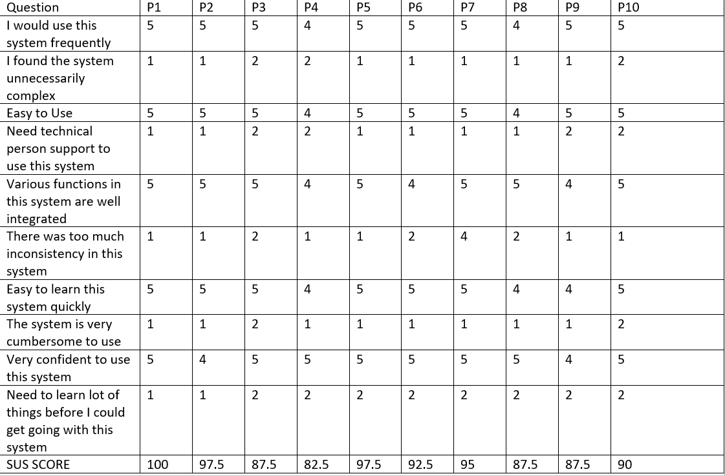
Patients SUS Questionnaire
Average SUS Score=

Slide 29
CONCLUSION
A home Hospitalization System based on cloud computing have been proposed.
This system allows patients to recover and receive treatment in their homes and among their families, where the patients’ health can be monitored periodically and a Web Application is designed for this purpose.
This system enables doctors, admin and patients to manage and monitor by logging into their accounts in web application.
This system is distinguished by its low cost, reliability, and safety in addition to its ability to solve the problems currently witnessed in hospitals, as it can substantially reduce the burden on them.

Slide 30
FUTURE WORKS
As a future work, This web application will be converted into a mobile application.
Some Additional Feature will be added in that mobile application which will be very useful for the patients.

Slide 31

Reference Paper
[1] Ben Hassen H, Dghais W, Hamdi B. An E-health system for monitoring elderly health based on Internet of Things and Fog computing. Health Inf Sci Syst 2019;7: 24–33. https://doi.org/10.1007/s13755-019-0087-z.
[2] Kaur H, Sood SK. Energy-Efficient IoT-fog-cloud architectural paradigm for real-time wildfire prediction and forecasting. IEEE Syst J 2019. https://doi.org/ 10.1109/JSYST.2019.2923635.

Slide 32
Reference Paper
[3] Sun H, Yu H, Fan G, Chen L. Energy and time efficient task offloading and resource allocation on the generic IoT-fog-cloud architecture. Peer-to-Peer Networking Appl 2020;13:548–63.https://doi.org/10.1007/s12083-019-00783-7.
[4] Rodrigues JJPC, Segundo DBDR, Junqueira HA, Sabino MH, Prince RM, et al. Enabling technologies for the Internet of health Things. IEEE Access 2018;6: 13129–41. https://doi.org/10.1109/access.2017.2789329.

Slide 33
THANK YOU

